Slide 1
The PNG Community Development Worker National Standard
Building the profession

Slide 2
The PNG National Standard for Community Development Workers is managed by the National Apprenticeship & Trade Testing Board (NATTB), a Government body.
A Government endorsed panel of experienced PNG Community Development Workers works with the NATTB to review and manage the National Standard. This panel is called the PNG Community Development Worker Industry Technical Committee (PNG CDW ITC).
Notes:
Getting there

Slide 3
The PNG CDW ITC identified the jobs commonly done by Community Development Workers. Then for each job they identified the key duties, and for each duty they identified the minimum skills and knowledge that need to be performed to meet the standard.

Slide 4
Units of the Standard
Core Units
Conduct community awareness
Assist group to analyse their development situation and identify priorities
Assist group to develop a project plan for a community activity
Facilitate agreements for a community activity
Facilitate the start-up of a community activity
Monitor community activity
Evaluate community activity outcomes
Conduct community training
Provide mentoring
Facilitate a specialist’s visit
Level 3 Units
Train trainers
CDW Workplace Assessor

Slide 5
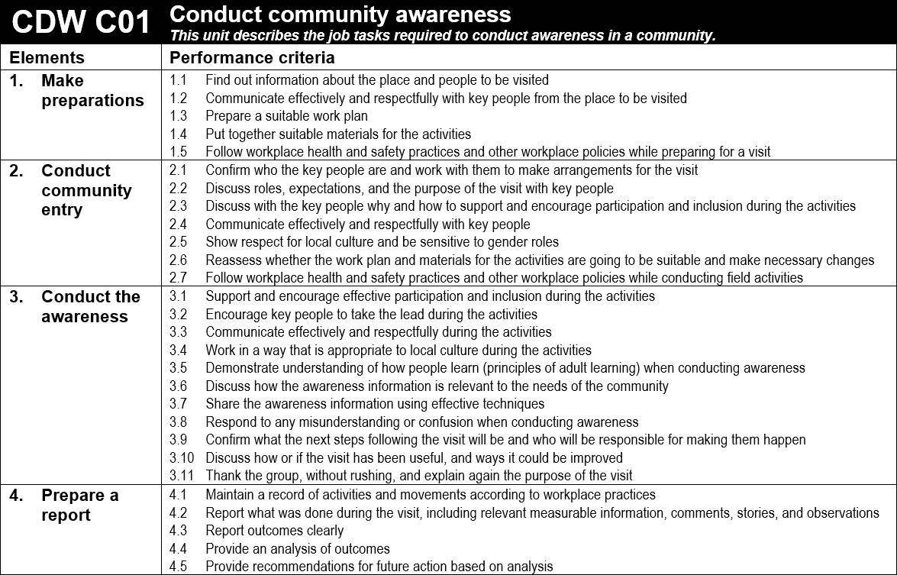
Example of a Core Unit
Luksave each Core Unit is broken into four duties (called ‘Elements’). Each Element is then broken into the minimum skills and knowledge (called ‘Performance Criteria’) that need to be performed to meet the standard. Element 1, 2 and 4 are the same in every Core Unit. What changes in each Core Unit is Element 3. Element 3 is called the ‘critical’ Element.

Slide 6
The National Standard helps Community Development Workers and the organisations they work for by providing:
A basis for Community Development Worker duty statements
A target for Community Development Worker training courses
Benchmarks for assessment of Community Development Workers
Recognition of skills held by people in both formal and informal employment
Certification for Community Development Workers that is nationally recognized
A common standard for Community Development Workers in PNG. Once a National Standard is set it drives innovation and leads to higher standards.

Slide 7
Once an organisation has decided which Units apply to the work that they do, they then need to support their Community Development Workers so that they understand and perform the required Performance Criteria.
Normally, organisations need to take 4 steps before their Community Development Workers can be assessed:

Slide 8
Step 1
The organisation needs to find out where the gaps are in the way its Community Development Workers do their work. If there are gaps the organisation may need to adjust workplace practice so that it allows their Community Development Workers to perform the required Performance Criteria.
Notes:
Getting there

Slide 9
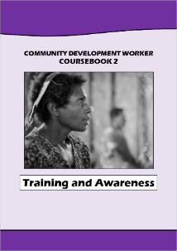
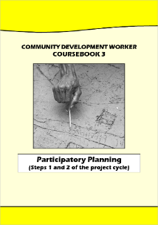
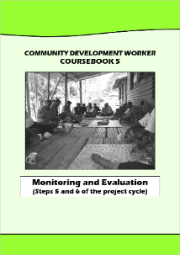
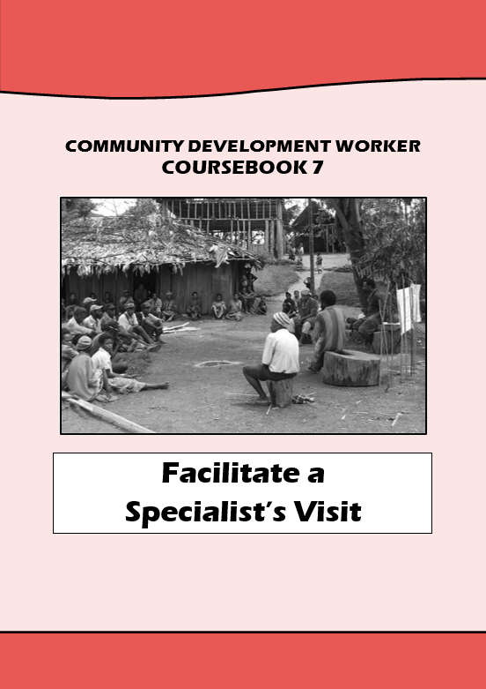
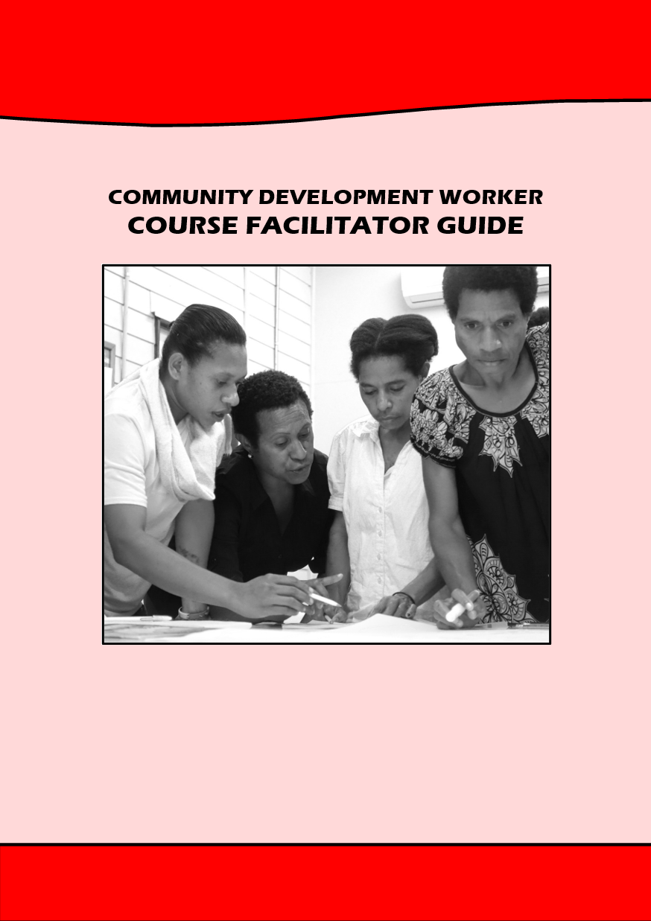
Step 2
If needed, train Community Development Workers to fully understand the Performance Criteria in the Units that apply to their work. Training coursebooks have been developed for each of the Units to help organisations conduct training.
These training coursebooks are available to download from pngcdwstandard.com

Slide 10
Step 3
Organisations need to make sure that their Community Development Workers put the Performance Criteria into practice when they do their work. Community Development Workers will then need to be encouraged and supported to perform the work expected of them.

Slide 11
Step 4
When a Community Development Worker feels that they perform the Performance Criteria for a Unit from the National Standard, then they can ask their employer to arrange an assessment by a CDW Workplace Assessor.
Community Development Worker organisations can have their own NATTB endorsed CDW Workplace Assessor, or they can arrange to use a partner organisation’s CDW Workplace Assessor.

Slide 12
The CDW Workplace Assessor assesses the candidate on the job, using official NATTB assessment instruments. Anyone can download the assessment instruments at pngcdwstandard.com (including the candidate). Although the candidate can see what they need to know and do before the assessment, what matters is whether the CDW Workplace Assessor observes them performing in a way that meets the standard during their assessment.
After the assessment, the candidate needs to keep a copy of the assessment in their own portfolio.
When the candidate believes they have met the requirements for CDW Level 1, 2 or 3, they can send a copy of their portfolio to the NATTB for verification and Government accreditation.

Slide 13
CDW Level 1 certificate
When the candidate sends a copy of their portfolio to the NATTB, a NATTB officer examines the candidate’s portfolio.
If the evidence demonstrates the candidate is competent for a full Core Unit (all four Elements), the NATTB will issue a Statement of Attainment for the Core Unit and a CDW Level 1 certificate.
If a candidate receives a CDW Level 1 certificate, then next time they are assessed for any Core Unit, they only need to be assessed for Element 3 (the ‘critical’ Element). This is because Element 1, 2 and 4 are exactly the same in each Core Unit, and the candidate has already demonstrated they are competent.

Slide 14
CDW Level 2 certificate
When the candidate sends a copy of their portfolio to the NATTB, a NATTB officer examines the candidate’s portfolio.
If the candidate already has a CDW Level 1 certificate, and their portfolio evidence demonstrates they are now competent in three more Core Units (making four Core Units in total), the NATTB will issue a Statement of Attainment for the three Core Units and a CDW Level 2 certificate.
However, one of the four Core Units must be CDW C07 ‘Assist group to analyse their development situation and identify priorities’. The unit CDW C07 is a compulsory unit if you want to become accredited as a CDW Level 2.

Slide 15
CDW Level 3 certificate
When the candidate sends a copy of their portfolio to the NATTB, a NATTB officer examines the candidate’s portfolio.
If the candidate already has a CDW Level 2 certificate, and their portfolio evidence demonstrates they are now competent for at least one of the Level 3 Units, the NATTB will issue a Statement of Attainment for the Level 3 Unit and a CDW Level 3 certificate for that Unit. For example, if the candidate is competent for ‘Train Trainers’ they will receive a ‘CDW Level 3 Train Trainers’ certificate.
Level 3 Units require advanced skills and knowledge, and extensive experience as a Community Development Worker.
For more information on how assessment and accreditation works, please visit pngcdwstandard.com to download the CDW Workplace Assessment Handbook.

Slide 16
For detailed information please visit pngcdwstandard.com
or phone NATTB (ph. 3017631)
Tok save click to the next slide and then just sit back and watch. The rest of this presentation auto-plays.

Slide 17
Conduct community awareness

Slide 18
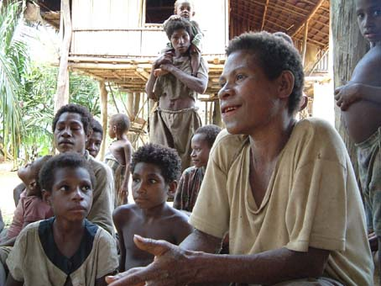
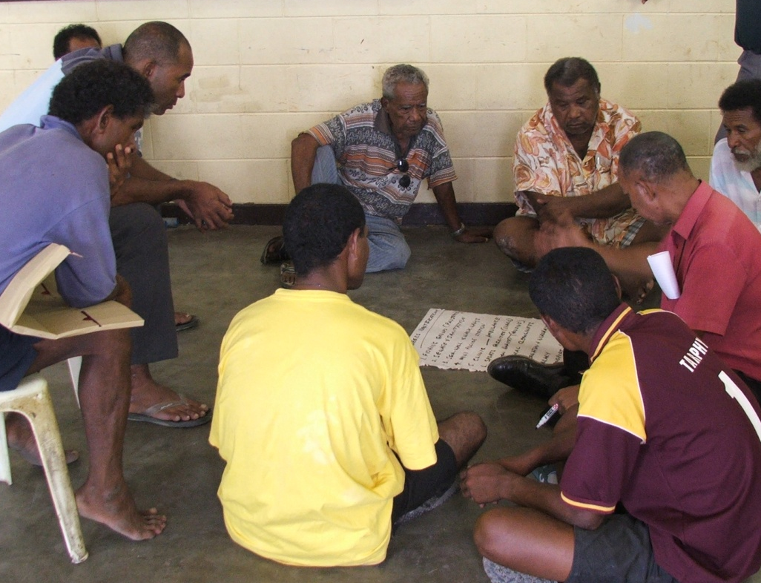
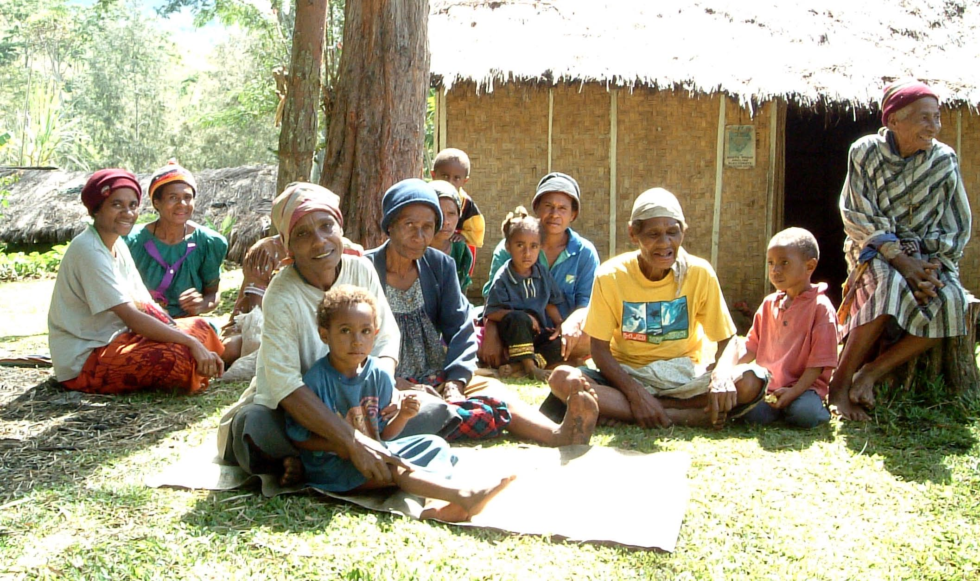
Notes:
Community mapping and needs analysis

Slide 19
Assist group to analyse their development situation and identify priorities

Slide 20
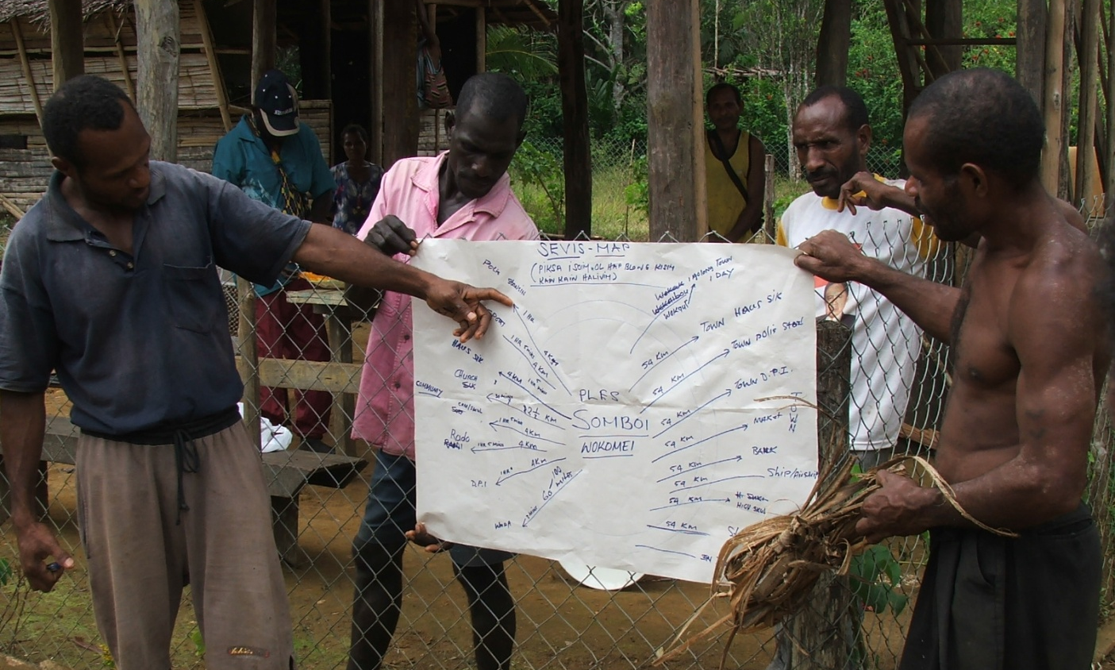
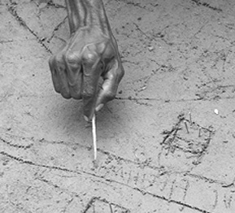
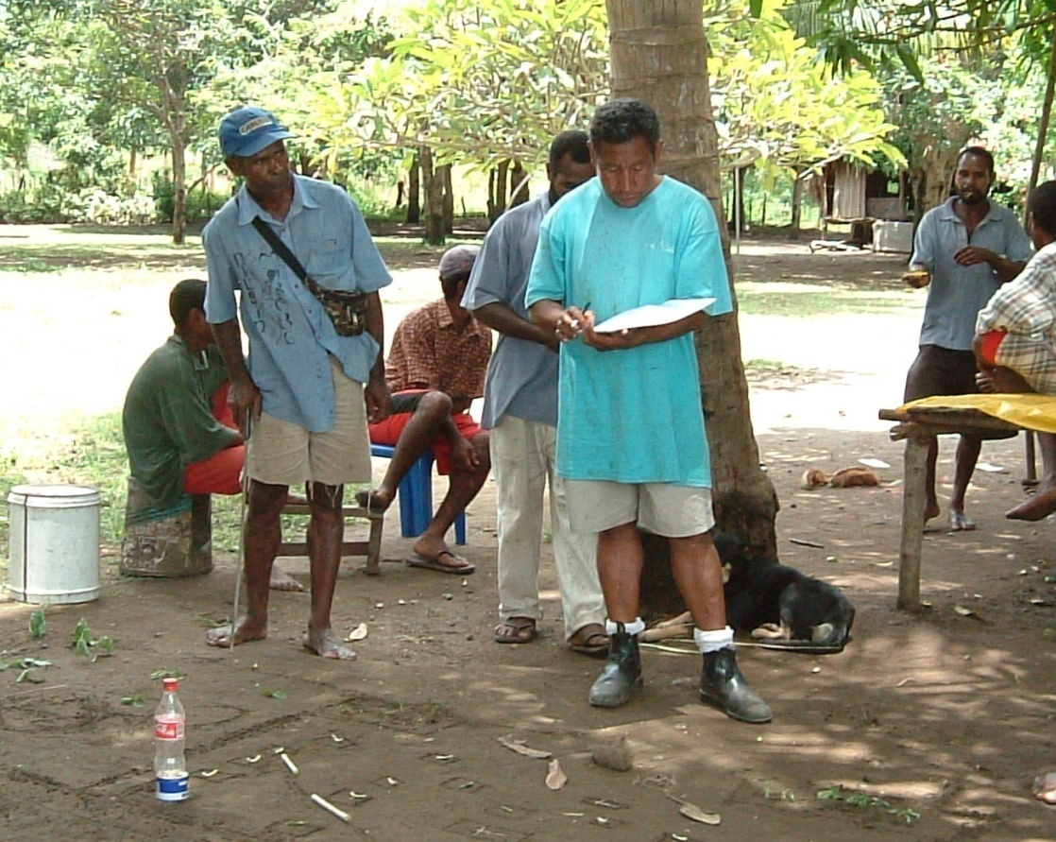
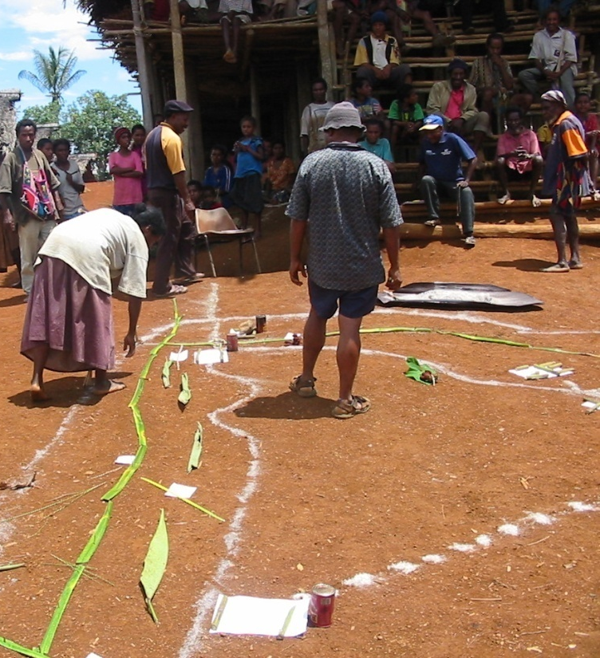
Notes:
Community mapping and needs analysis

Slide 21
Assist group to develop a project plan for a community activity

Slide 22
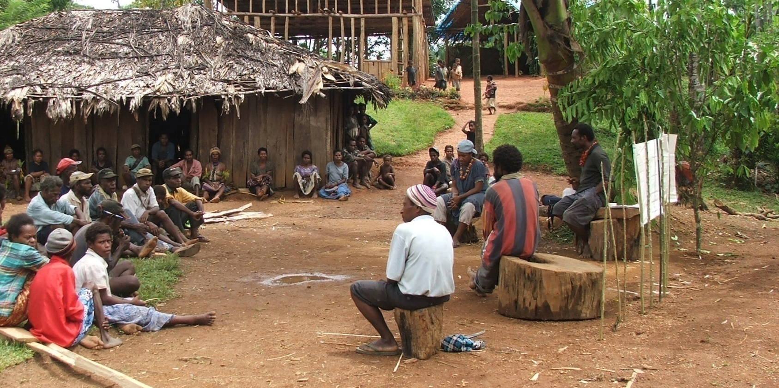
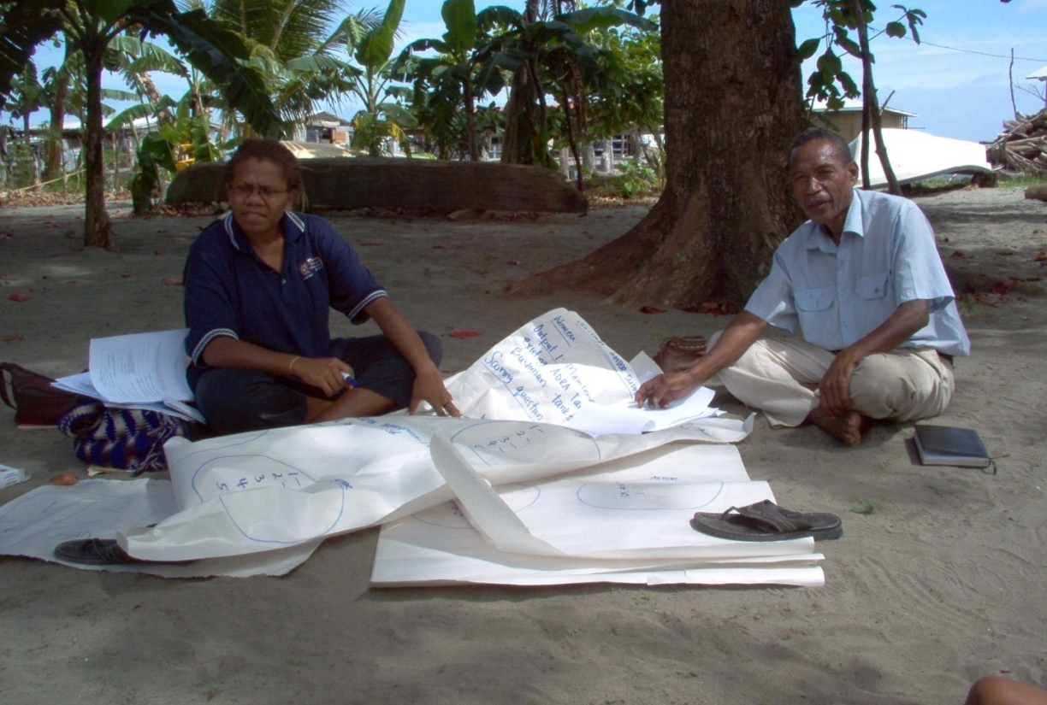
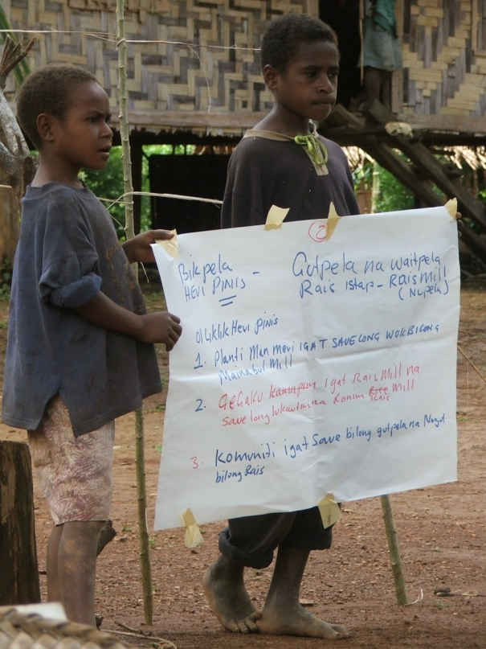
Notes:
Finalising plans

Slide 23
Facilitate agreements for a community activity

Slide 24
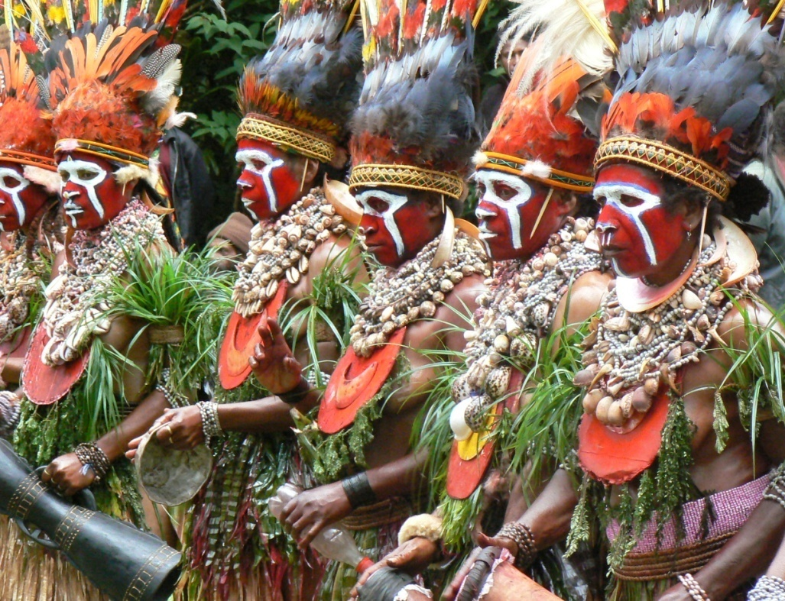
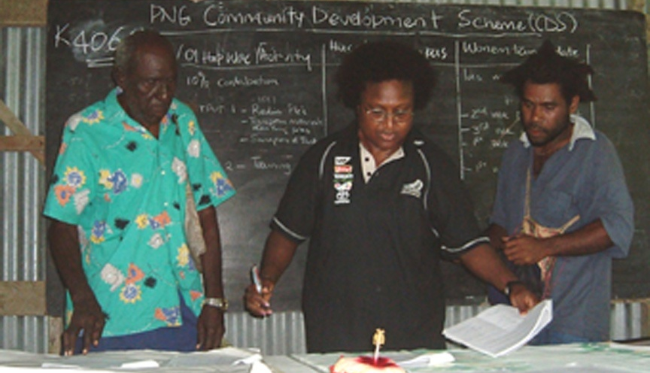
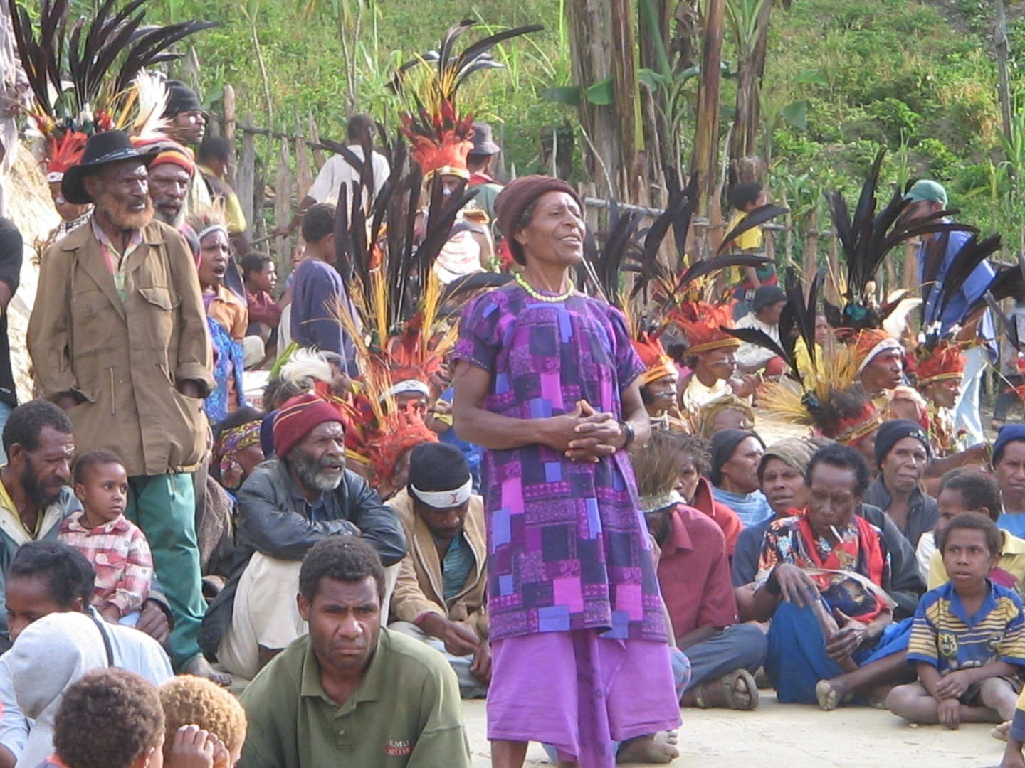
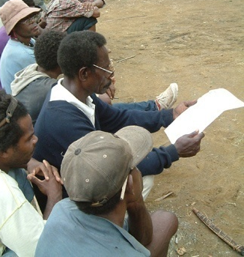

Slide 25
Facilitate the start-up of a community activity

Slide 26
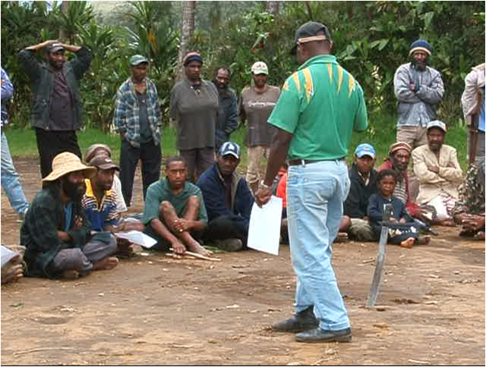
Notes:
Agreement

Slide 27
Monitor community activity
Notes:
Getting there

Slide 28
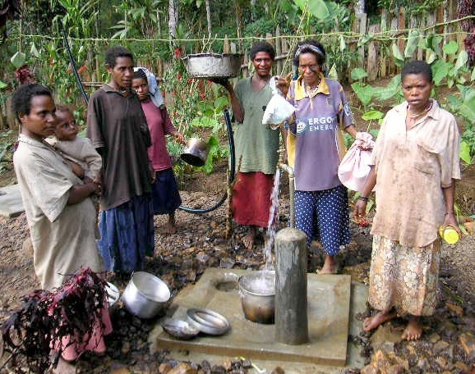
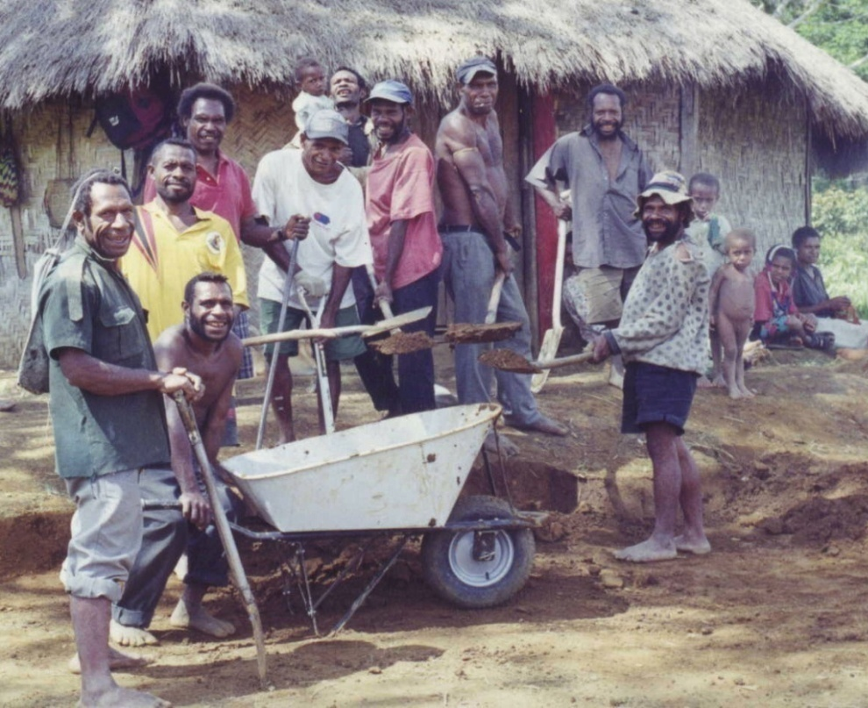
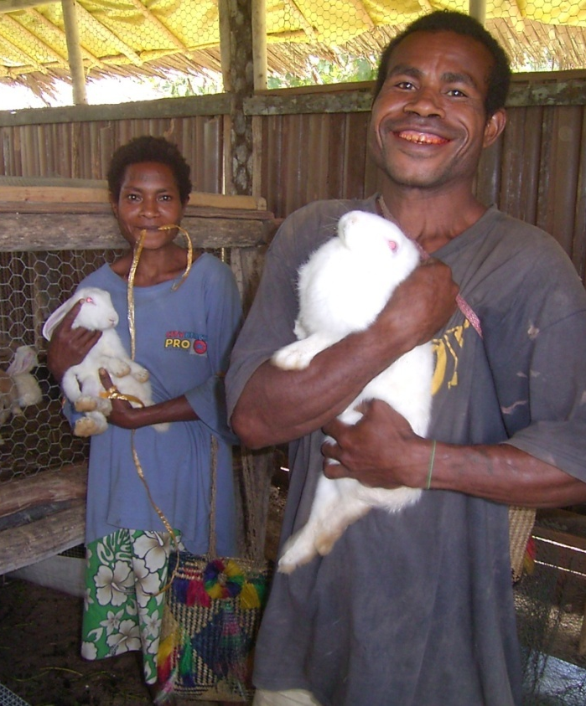
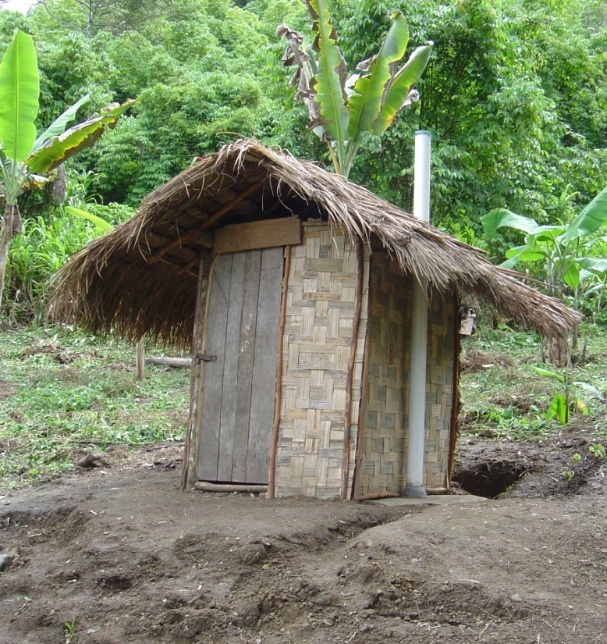
Notes:
Implementation and monitoring

Slide 29
Evaluate community activity outcomes

Slide 30
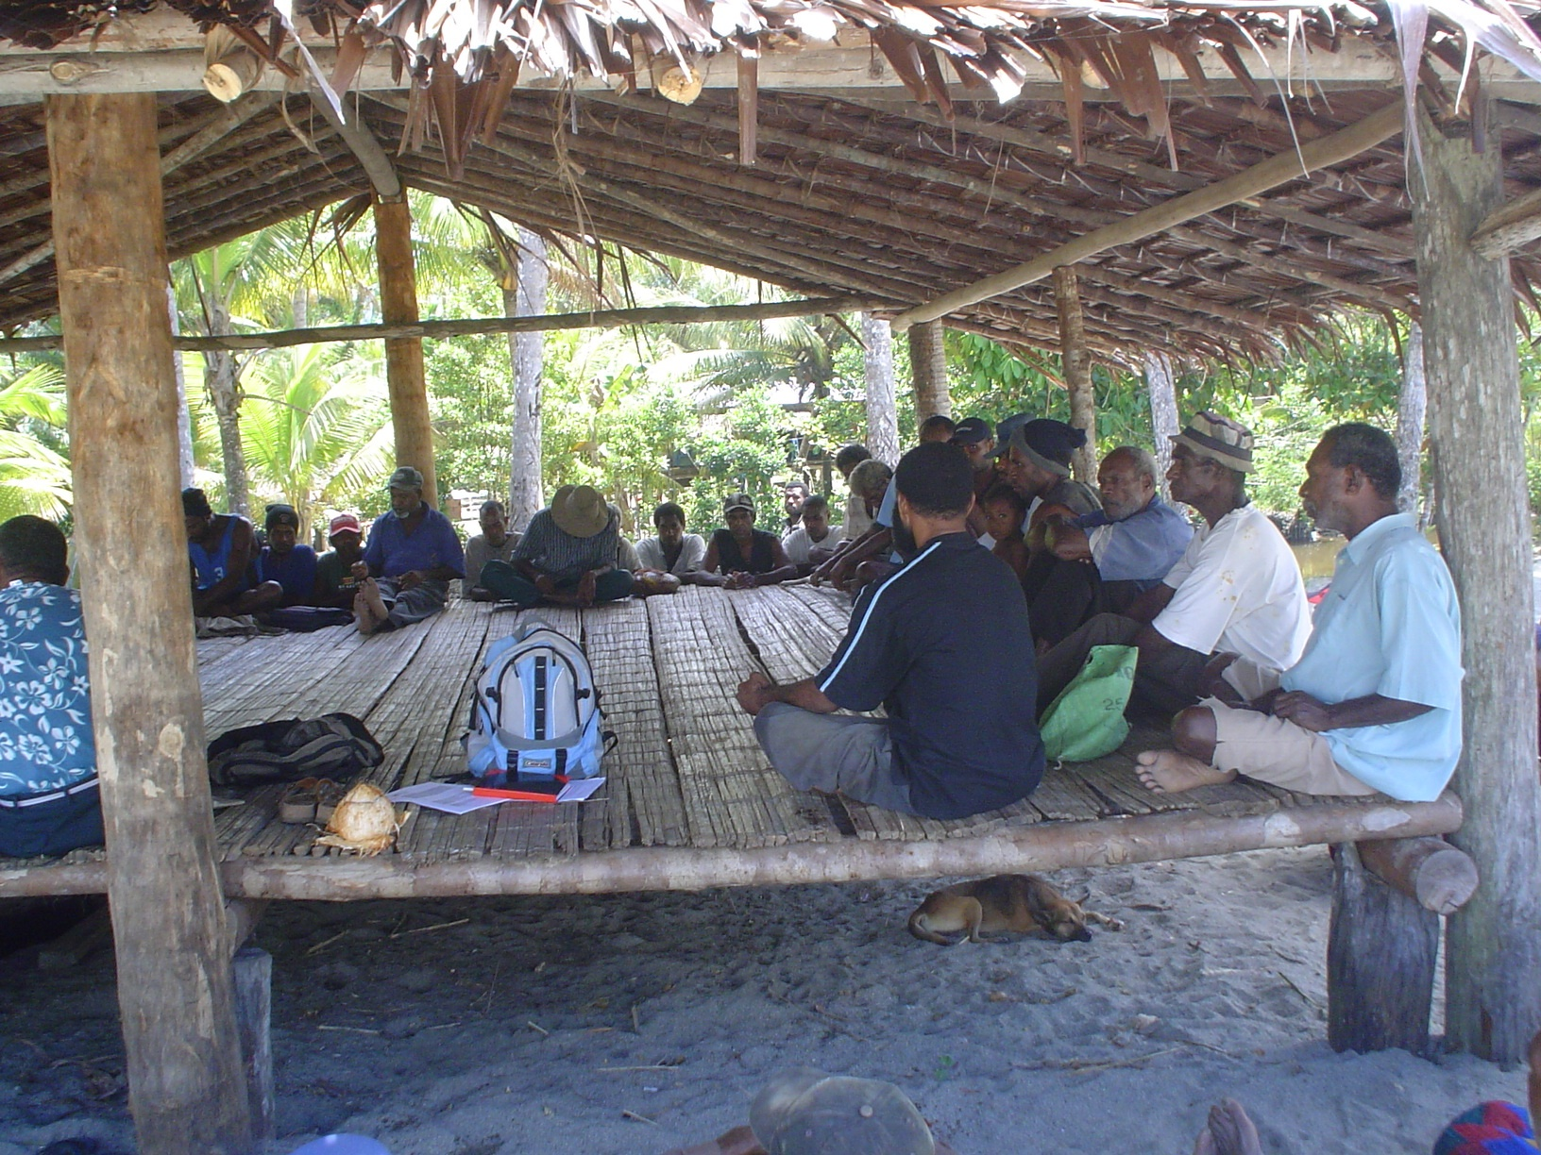

Slide 31
Conduct community training

Slide 32
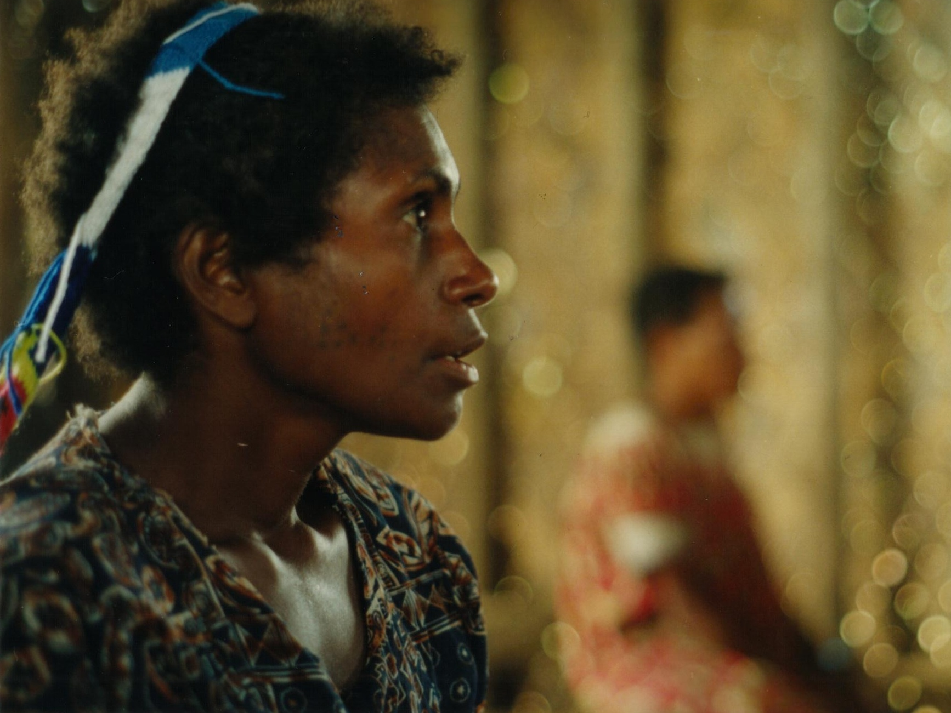
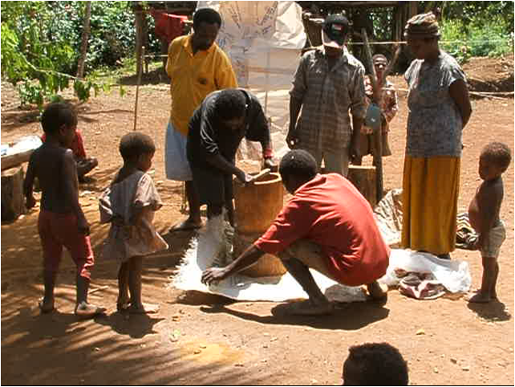
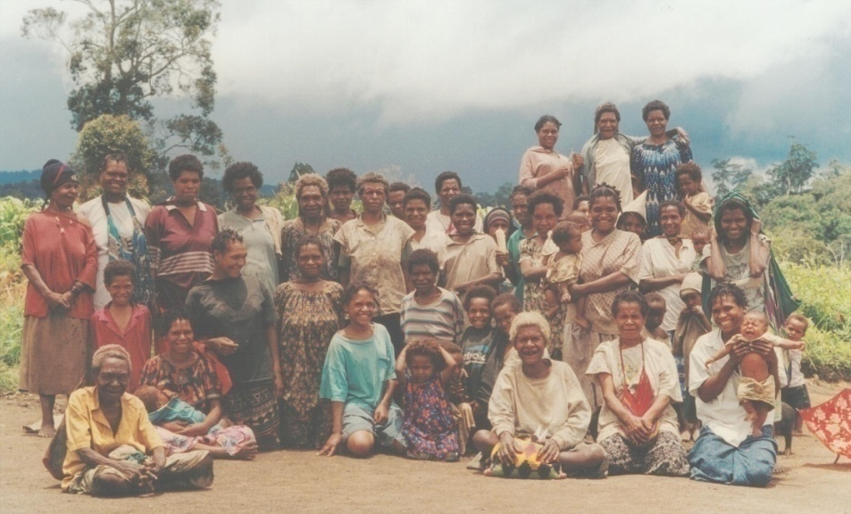
Notes:
Transfer skills

Slide 33
Provide mentoring

Slide 34
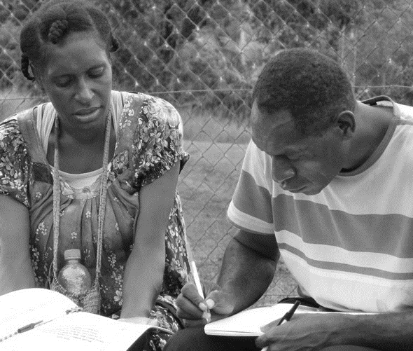

Slide 35
Facilitate a specialist’s visit

Slide 36
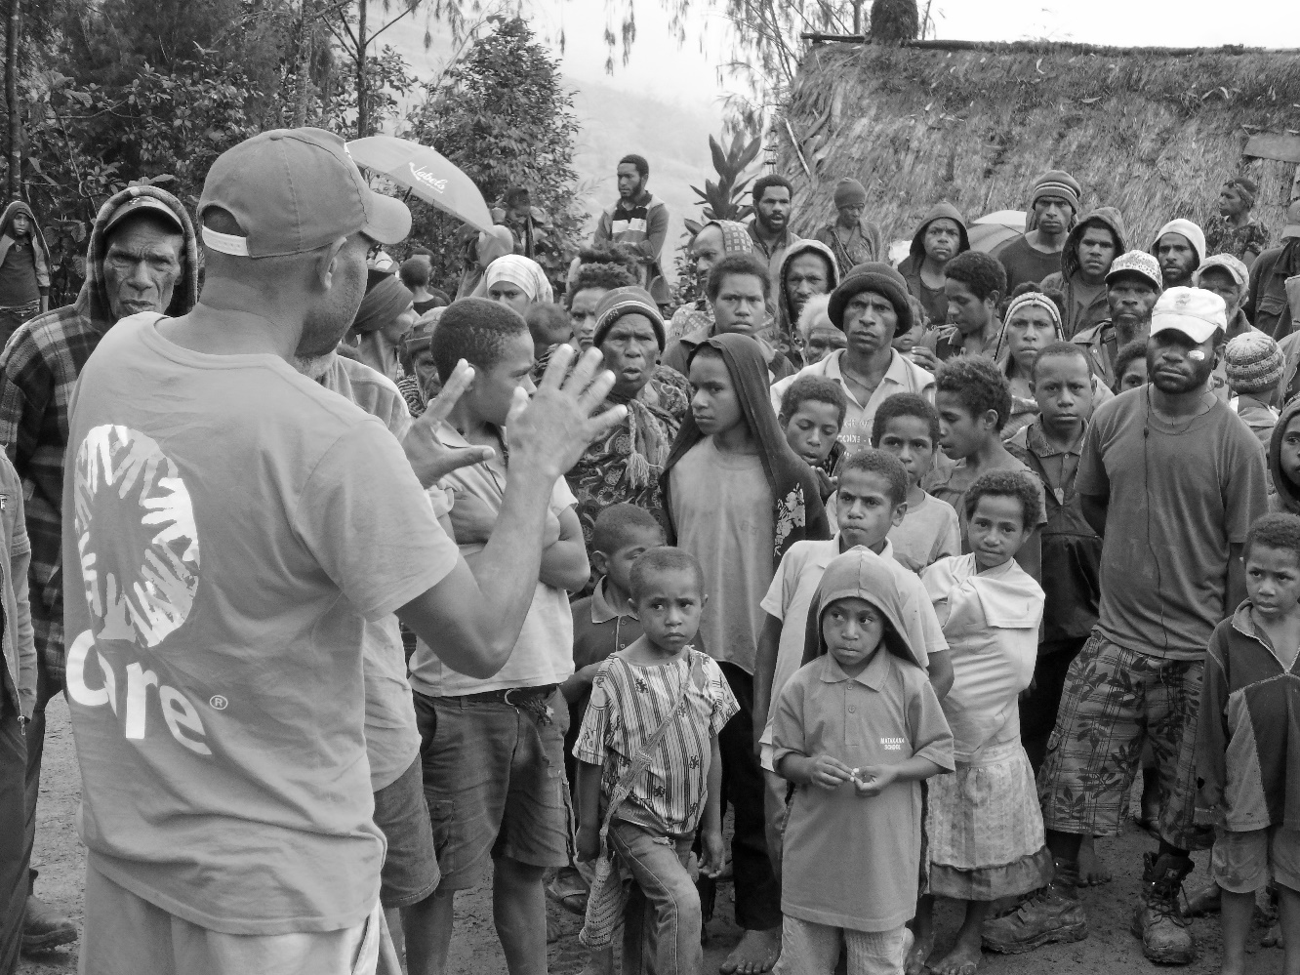
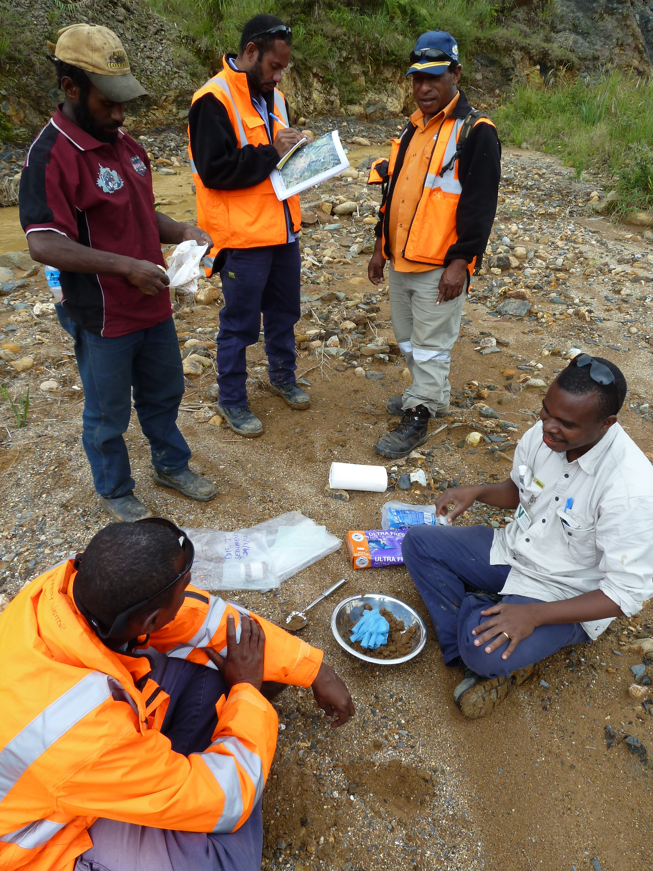
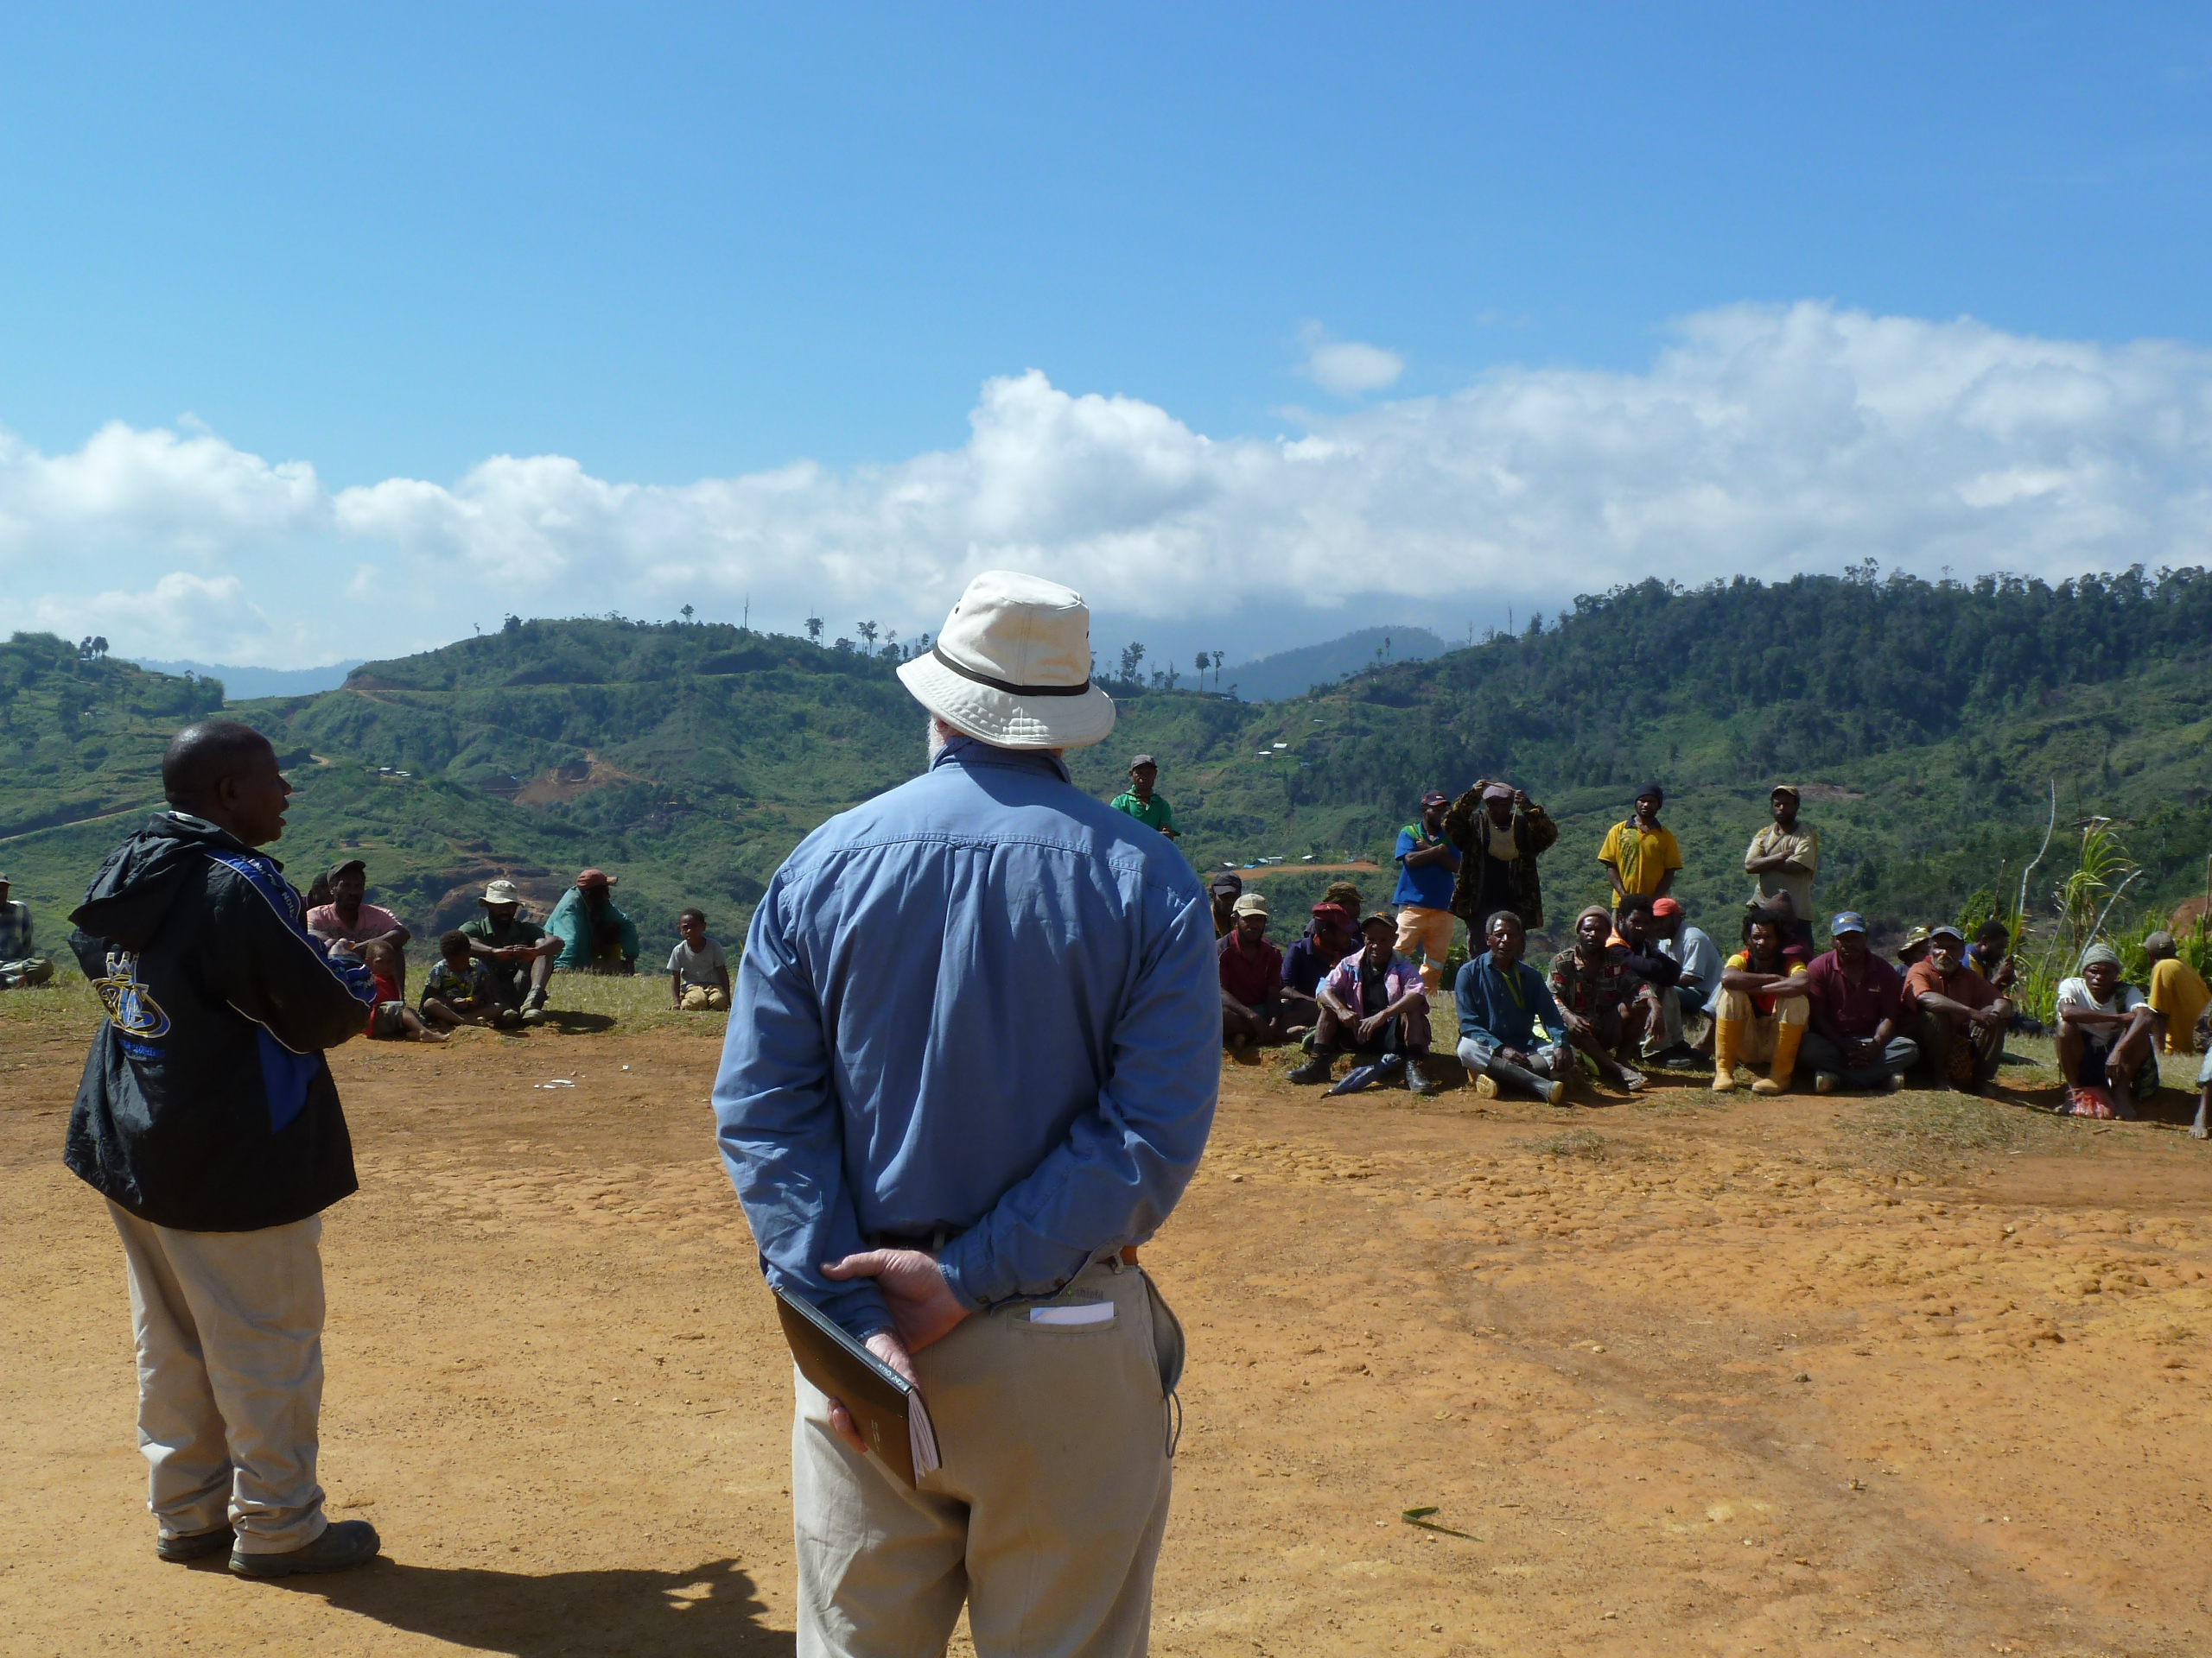
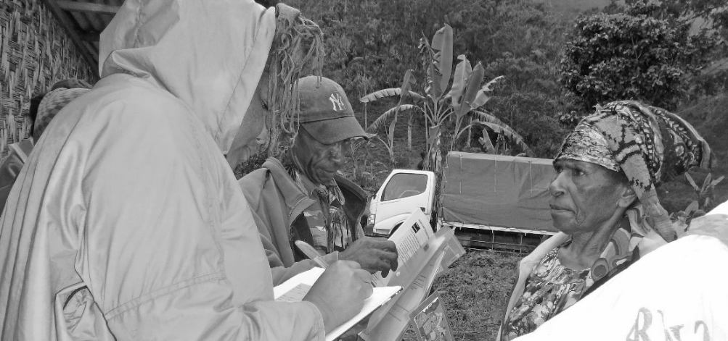

Slide 37
Train trainers

Slide 38
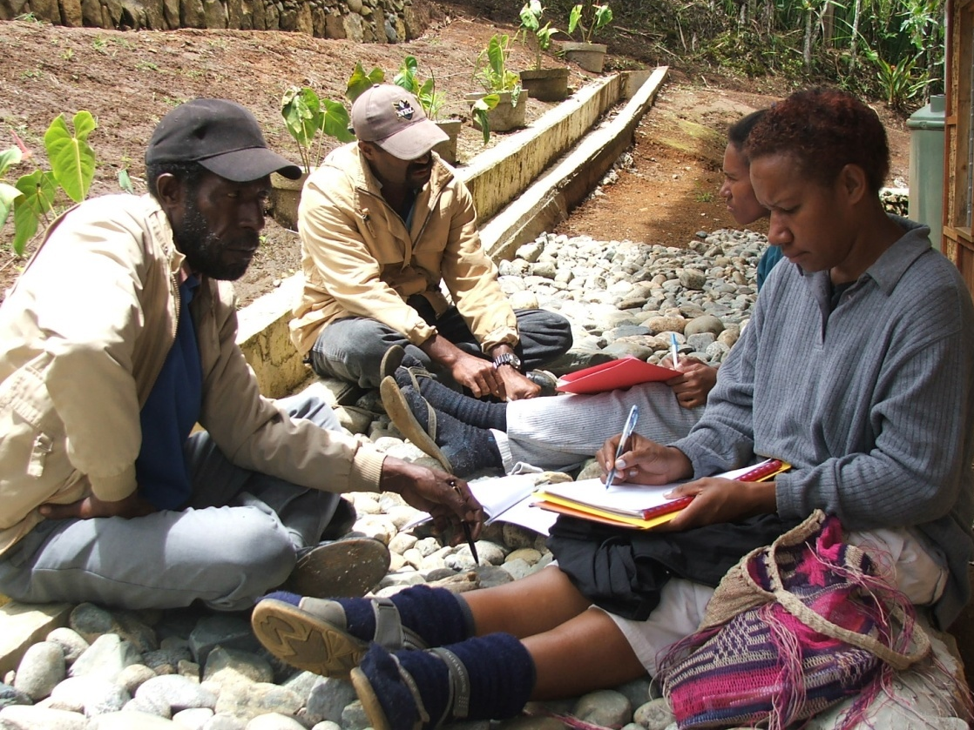
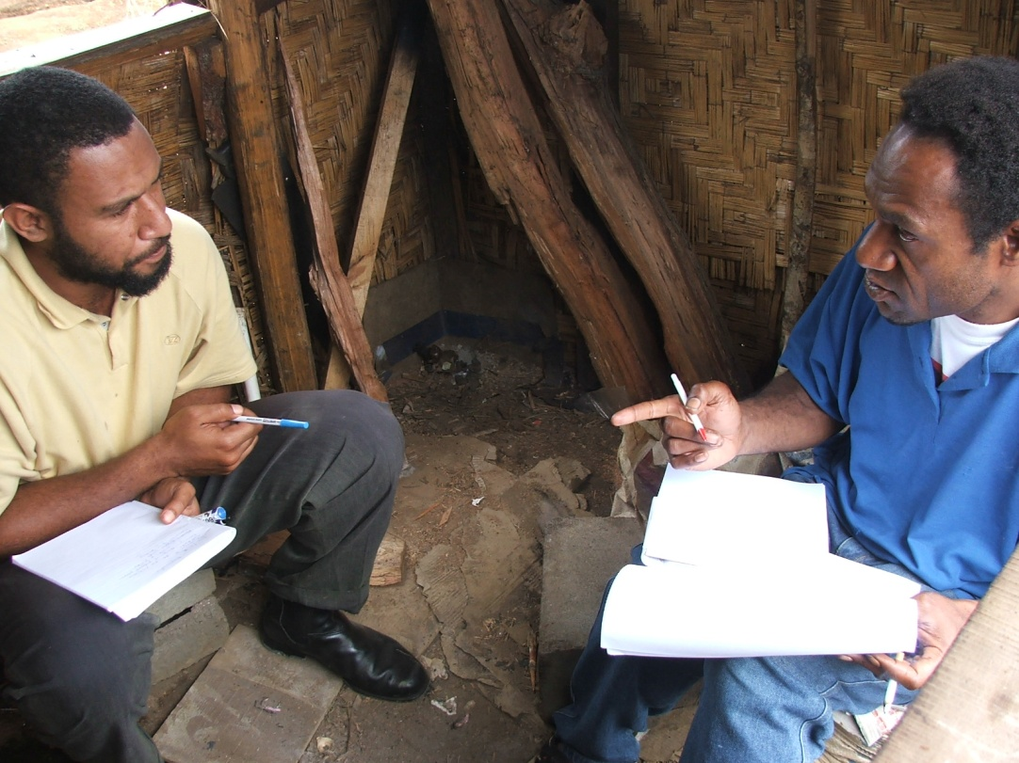
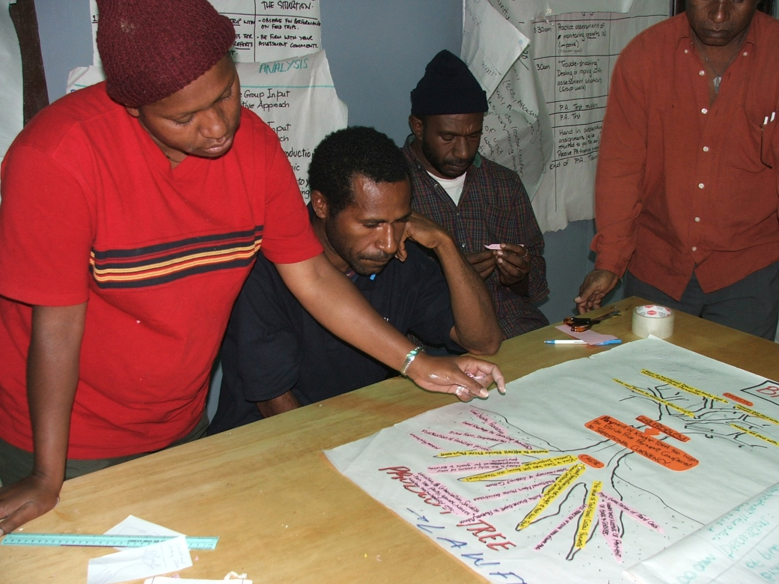
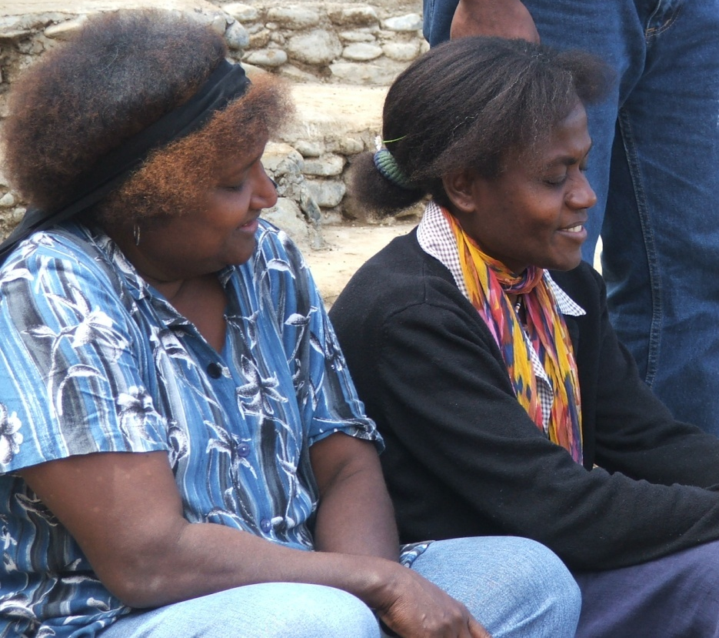
Notes:
Training of Trainers

Slide 39
CDW Workplace
Assessor

Slide 40
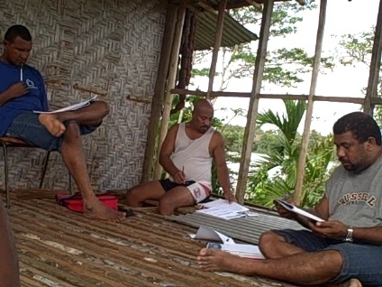
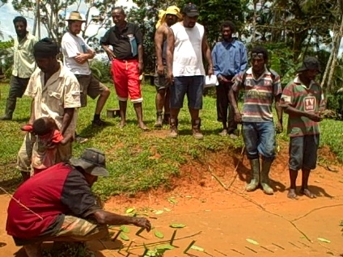
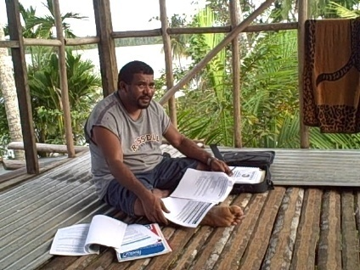

Slide 41
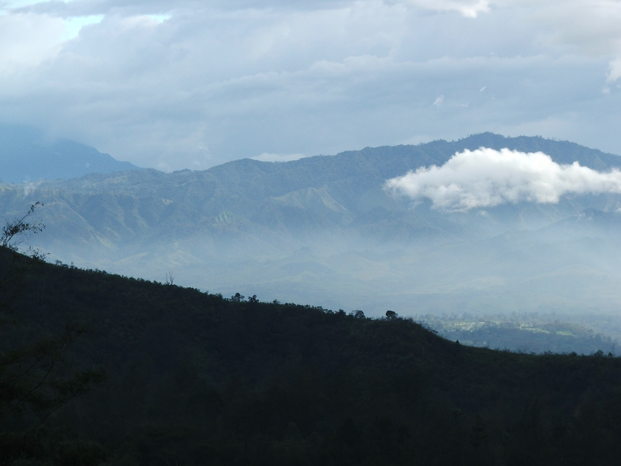
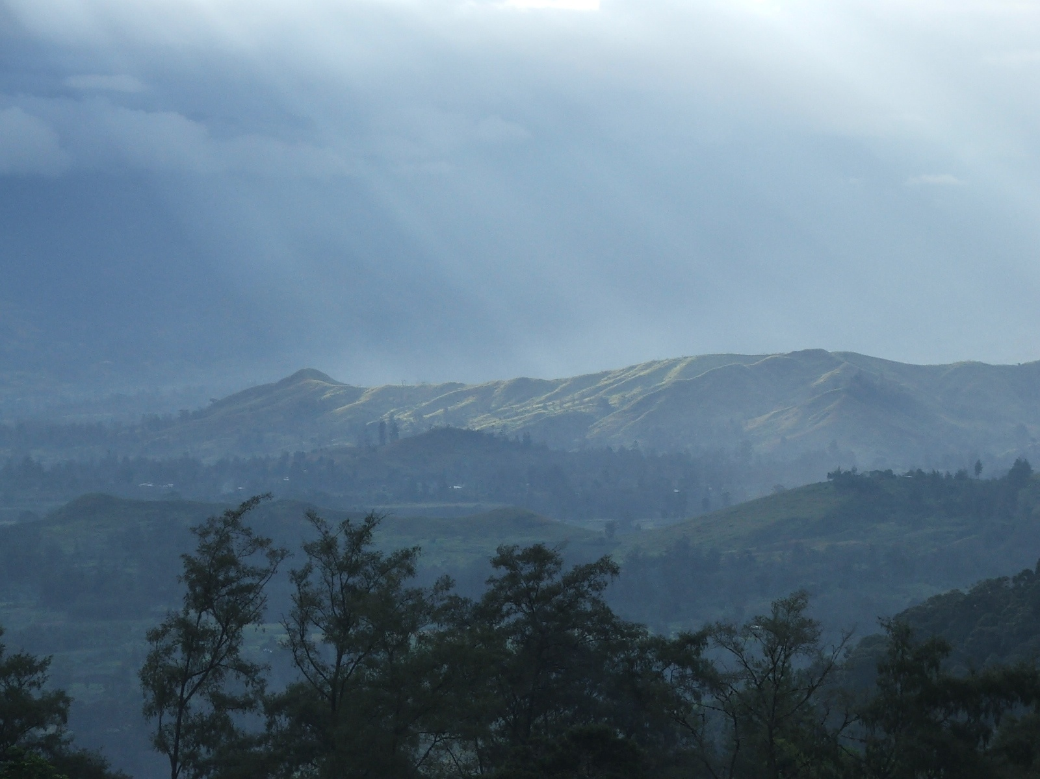

Slide 42
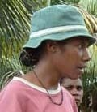
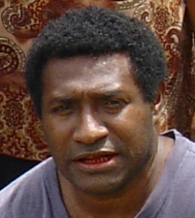
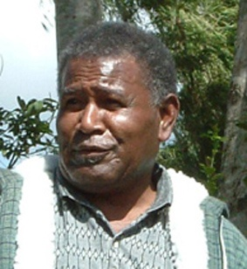
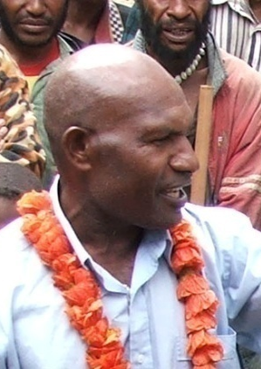
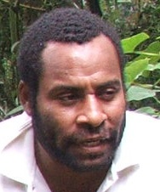
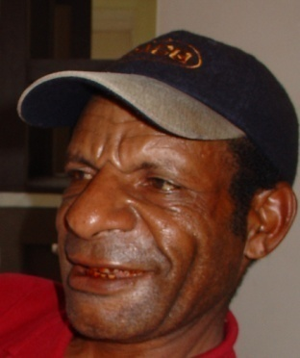
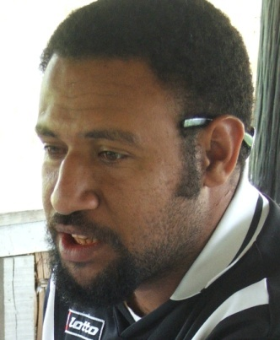
Community Development Workers
District officers
Community volunteers
Ward development committees
Extension Workers
Field Workers
Liaison officers
Community Affairs officers
School leavers

